Slide 1

Video Conferencing Systems
170444027 - Ilgın GÜRSOY
180444044 - Mustafa Emirhan ALKAN

Slide 2
CONTENTS
Frontend
İnterface
Backend
Database
Figman
Registration system

Slide 3
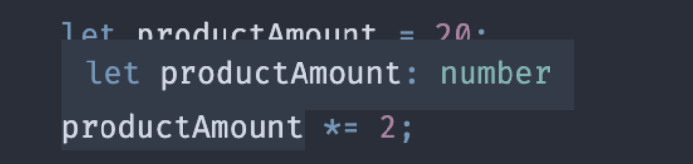

Frontend
Typescript React: TypeScript is a software language developed by Microsoft. It is a superset of JavaScript and has its own compiler. The type of variable that you specify once always remains constant in the code stream.
For example;
Electron: Electron is a free and open source software framework developed and maintained by GitHub. It allows the development of desktop GUI applications using web technologies.

Slide 4
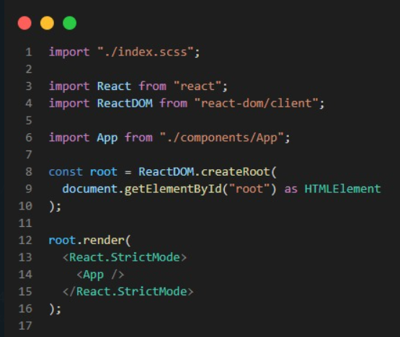

Slide 5
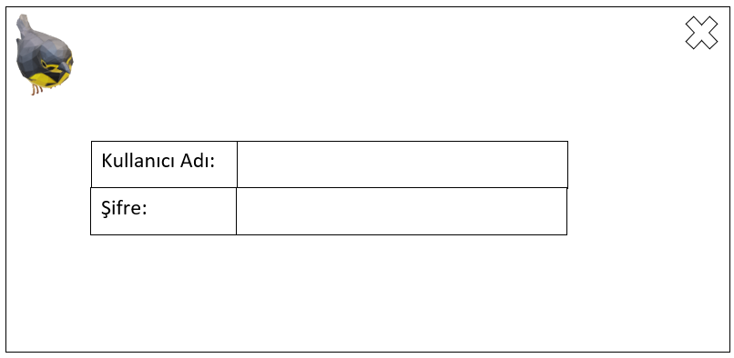
Interface
The interface is expressed in the form of a front page with various images, graphics, articles that allow computer software to be run by the user.

Slide 6
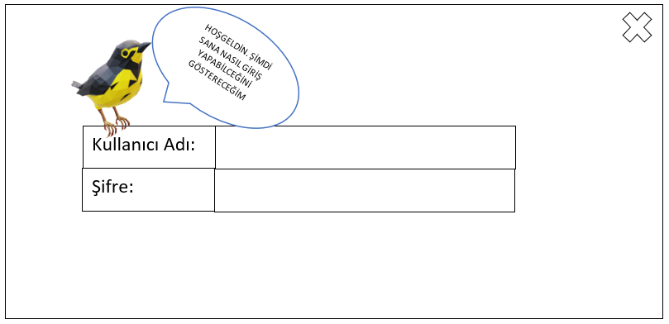
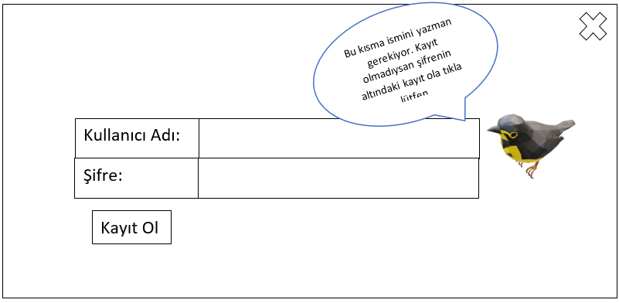
Introduction Animation
The animal, which is our mascot, enters the screen from the corner and greets the user. Then begins the introduction. It tells you where to write the name and password, how to close the application, how to register by showing them. After entering the application, our mascot continues the introduction and shows the place where the lesson will be registered, the rooms where it will be invited, the place where the lesson will be processed and the location of the games. Then it disappears. Different mascots will be seen in games on assignments and in most parts of the application.

Slide 7
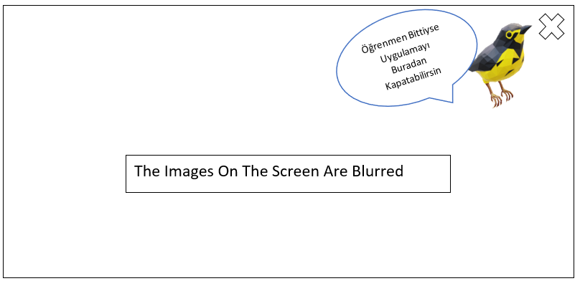

Slide 8


Backend
Web RTC: It is a free, open-source project that provides real-time communication (RTC) to web browsers and mobile applications through simple application development interface (APIs). It allows audio and video communication to be easily used on web pages.
Gin: Gin is a web framework written in Go (Golang). It features a martini-like API with performance that is up to 40 times faster thanks to http router. If you need performance and good productivity, you will love Gin.
Pion: The Open Source, Cross Platform Stack for Real-time Media and Data Communication.

Slide 9
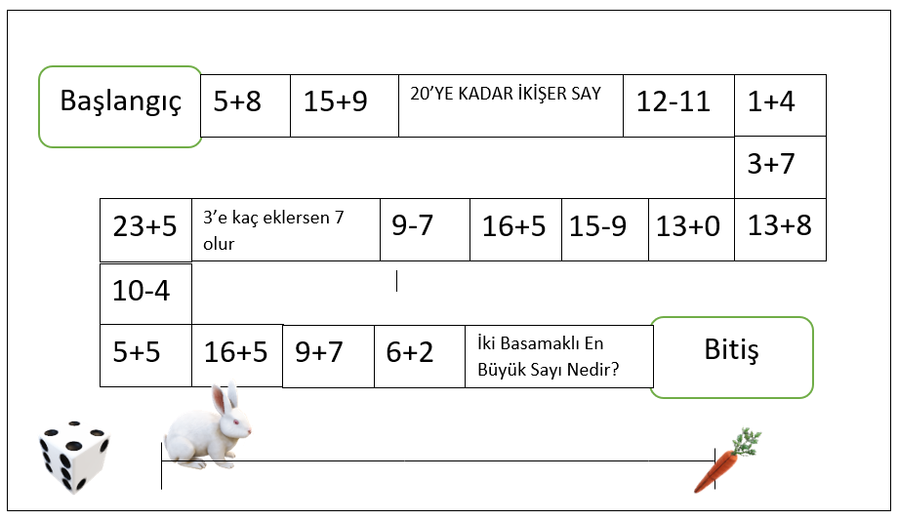
Examples of games we use:
1) The rabbit game
The rabbit game that will be found in our application is a game for young students that allows them to learn addition, subtraction, division and multiplication in a fun way.
Purpose: The aim of the game is to move forward on the map with the numbers coming on the dice and to deliver the rabbit to the carrot by doing the corresponding operation correctly. With each correctly known question, the rabbit gets closer to the carrot, and if no more than 3 mistakes have been made, the rabbit gets to the carrot. The game can be made difficult and easier by adding and subtracting the desired operations and increasing the difficulty.
Transactions: The Dice Rotates on the screen-> Moves Up to the Digit -> The answer to the operation is entered by the user -> If it is incorrect, the Red Light turns on and the correct answer comes out and the dice roll -> If it is correct, the dice roll again -> Continues until the end.

Slide 10
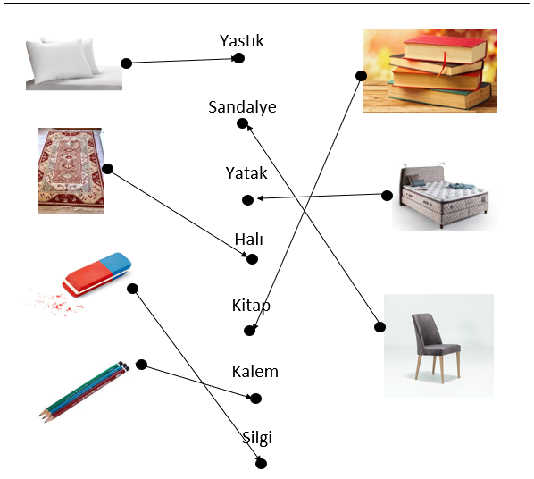
2) The matching game
The aim of the game is for the student to match the picture he sees on the screen with the name of the item in that picture. As you move on to the difficult parts of the game, the number of items and the number of words do not match and the wrong words are given. When there are items left empty, the student is expected to write the name of that item.

Slide 11
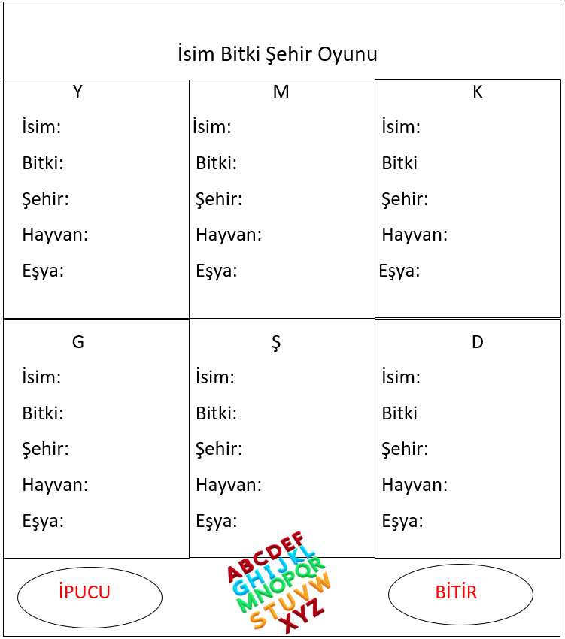
3) Name city game
In this game, the student tries to fill in the names, plants, cities, animals and items equivalent to the words given below in such a way that they begin with the letter given above. The game result is sent to the Teacher and can be done as a classroom activity. A few of the words that are not filled with a hint are filled in. It can be played with letters Dec 1 to 6.

Slide 12
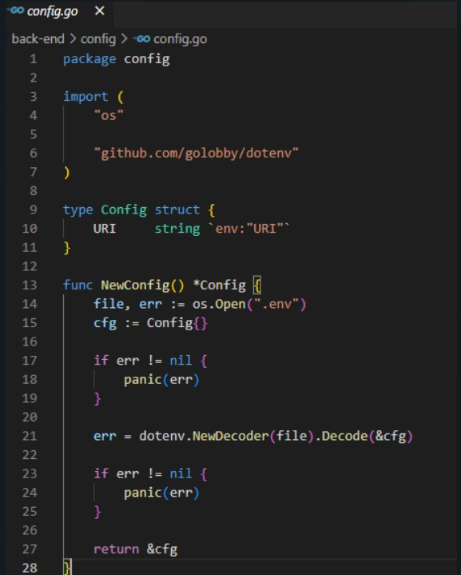
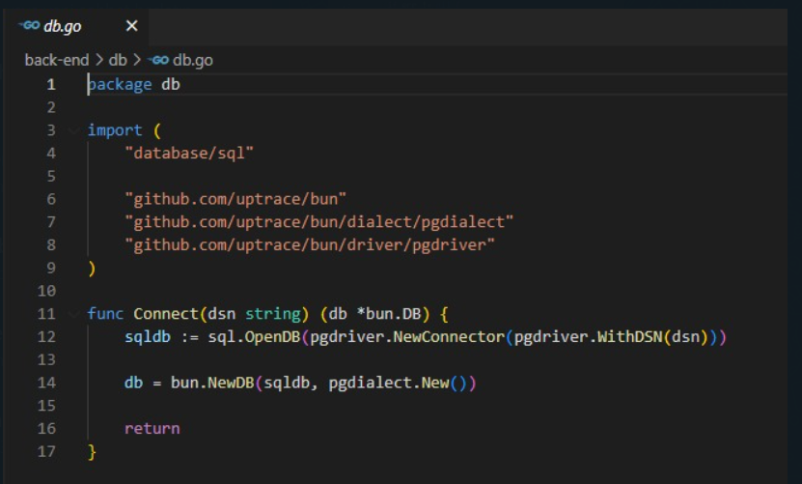

Slide 13
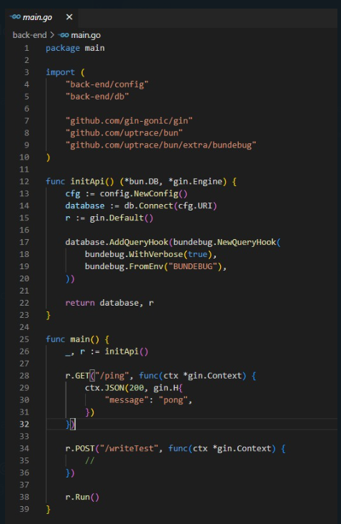
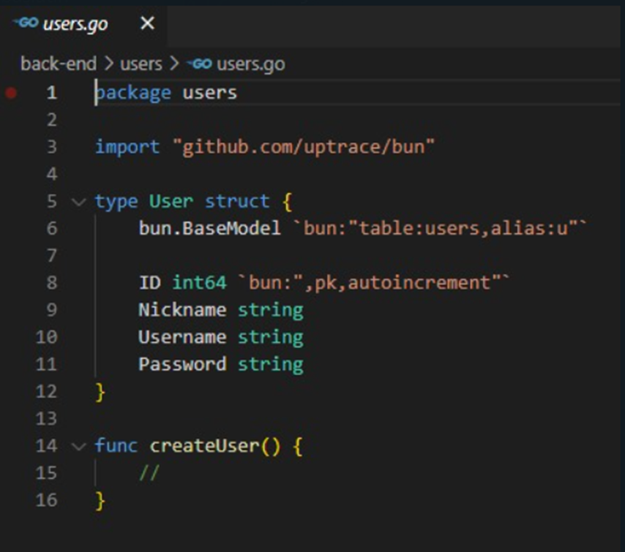

Slide 14

Database
Postgres: Postgres is a free and open source, SQL-supported relational database management system.

Slide 15

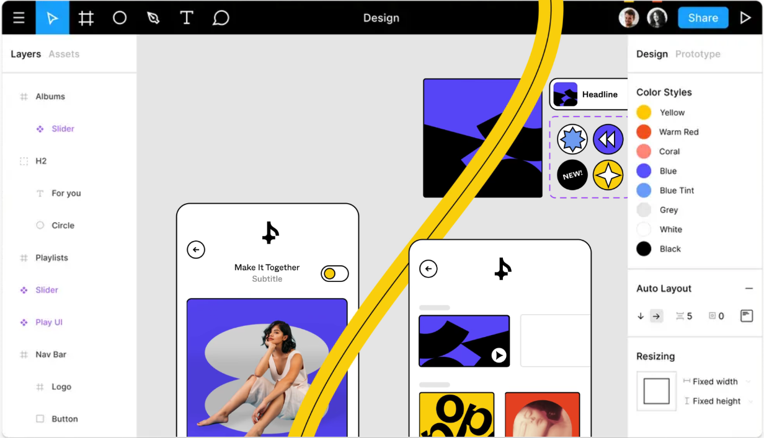
Figma
Mockup is used for creating corporate identity from printed works such as business cards, brochures, catalogs and applications, from websites to mobile applications to create how the design will look like within the framework of a model / model, in the area to be applied and on the surface.

Slide 16
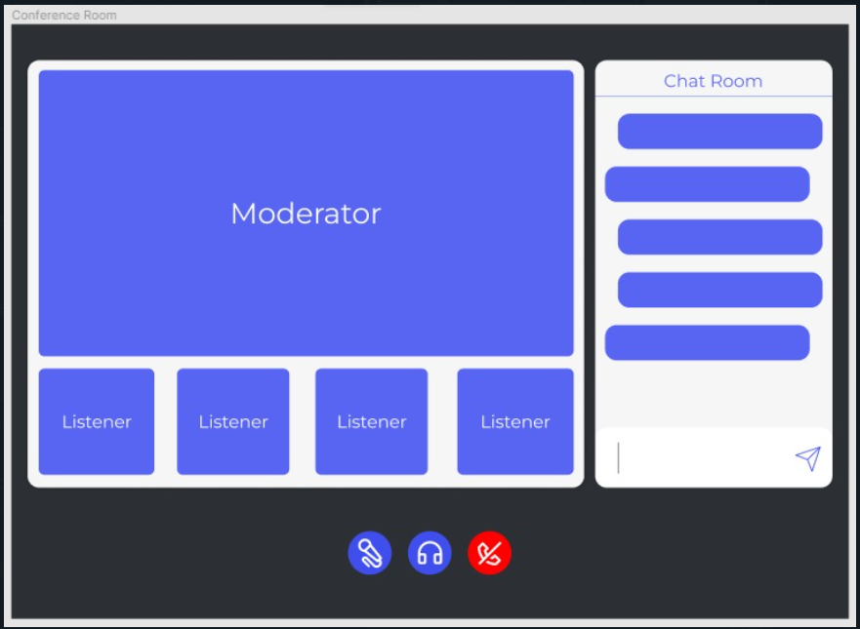

Slide 17
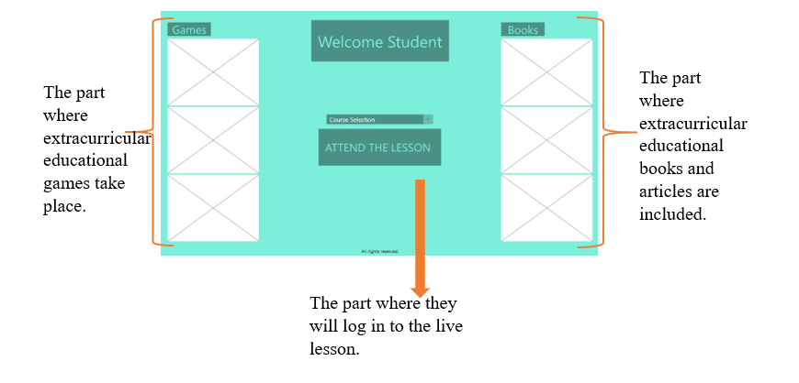
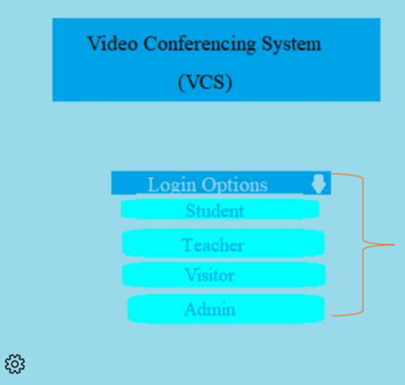
Registration system
User Interface (UI) : Interface is intended for experience-oriented improvements, such as allowing users to navigate the site Decently and stay on the site for longer periods of time to access the site's content more conveniently.

